Slide 1
Intro to the {tidyverse}: Essential R Packages
Pat Callahan
UCSF Memory and Aging Center
8/11/2020
Notes:
Welcome, and thanks for coming to pres. on the tidyverse packages, or what I consider to be the essential R packages
Logistics: please direct questions to ? via the Zoom chat feature. I'll answer as many as possible at the end of the presentation. If it'll be useful, make sure to also associate your question with a slide number.
Assumptions: you have at least a beginner knowledge of R; that is, you’ve opened R and maybe even used it as a fancy calculator. Otherwise, i expect minimal knowledge
Pat Callahan, CRC with the Rankin lab coming up on 2 years
Have done a lot of R coding work, and spent a large chunk of time in the last few years gaining domain expertise. When beginning that journey, I started with Base R and whatever random packages came my way
Base R can get data cleaning and preparation jobs done, yes, but man was it a slow, unfriendly, and frankly unrewarding process to learn how to do these processes, and then actually accomplish them.
I worked to make this presentation the best distillation of data cleaning and prep that I could come up with
Hopefully some of what I teach today will help others avoid wasting time learning unnecessary Base R approaches.
Programming and code should only serve to expedite processes and alleviate our workloads

Slide 2
Learning Goals
Overview of the Tidyverse and its packages
Benefits of the Tidyverse
Tutorial demonstrating a “tidy” workflow
Notes:
Will review Tidyverse goals, philosophy, and the major packages in it
For those unfamiliar, a package (library in lots of other languages) is a set of publicly-released tools or functions that you can download and use.
Explain how those packages can be beneficial to you
To see those 2 points in action, present a tutorial of some of the core packages and functions from the Tidyverse
Moreover, I want the tutorial to serve as a quick-start guide for some of the most essential data cleaning tasks

Slide 3
What is the Tidyverse?
Collection of data reading, writing, cleaning, manipulation, and workflow packages designed for data science
Authored and maintained by RStudio
Jim Hester, Yihui Xie, Jenny Bryan, Hadley Wickham, many more
Designed to be cohesive and interfunctional
Notes:
At its core: packages for data science and preparation; not so much meant for analysis, but allowing you to prep data for analysis
Authored by RStudio totally free as the use of these packages make R more appealing and thus improve their business.
Quick note on RStudio: most popular IDE for R. An IDE is a one-stop shop for interactively writing, running, and editing code
Sometimes referred to as Wickahmverse
Packages designed with one another in mind, possible due to central administration
Ok so we know that the tidyverse is a bunch of data science packages—what strings them all together?
Phonetic: ye-we shea

Slide 4
Tidyverse Philosophy
Shared grammar across packages
Learn 1 package, learn them all*
Oriented around functional programming and simplified workflows
Pipe operator, multi-function construction, etc.
Code should be human readable, machine executable
Function naming scheme: verb_*()
Ex: read_csv() and filter_at()
Notes:
Shared grammar so the argument naming, function naming, and documentation all mesh with one another super well. Learn how to use one package in a general sense, and learning another becomes trivial
Shared API asterisk(*): ggplot2 was developed very early so it struggles to adhere to some of the rules, but everything else is A+ in sharing structure
Improved workflow through the pipe operator
Human readable, machine executable is a simple but elegant concept emphasizing the need for humans to simply read the code and understand it
Realized through clear, consistent function naming scheme:
Verb_*() is general structure to first declare what action the function takes on, often verb_adjective() or verb_noun()
Example of this is filter_at(). Even if you don’t know anything about R, you can presume that something is going to be filtered on a certain condition and ”location” so-to-speak

Slide 5
5 Reasons to use {tidyverse}
Execution Speed
Many functions outsourced to C++ for efficiency
Default documentation
Opinion: package vignettes and function help is great
Functional and convenient
Pre-existing functions for most data cleaning procedures
“Because everyone else uses them”
Existing explanations at Stack O and RStudio Community
Readability of your code
Easier to write, share, reproduce, and understand later
Notes:
Going to tell you reasons why you should use these packages now, and I’ll make the case for them later or ask you to take my word for it.
2. There are whole websites dedicated to each package that detail the purpose of each function, and show examples on how to use them.
3. Packages developed by data scientists and statisticians for use by others, and constantly developing more
4. Some older resources suggest using Base R or data.table package. Standard over last 5 years is the tidyverse. Take my word or check Google.
5. Cannot understate the significance of this final point. If you want others to review your code, help with it, and understand your analyses, then it must be clearly readable. If you want to review your code 5 years from now or reuse it for another project, you need to be able to read, understand, and likely alter what you did.
General overview of tidyverse complete, now what are the packages that comprise it?

Slide 6






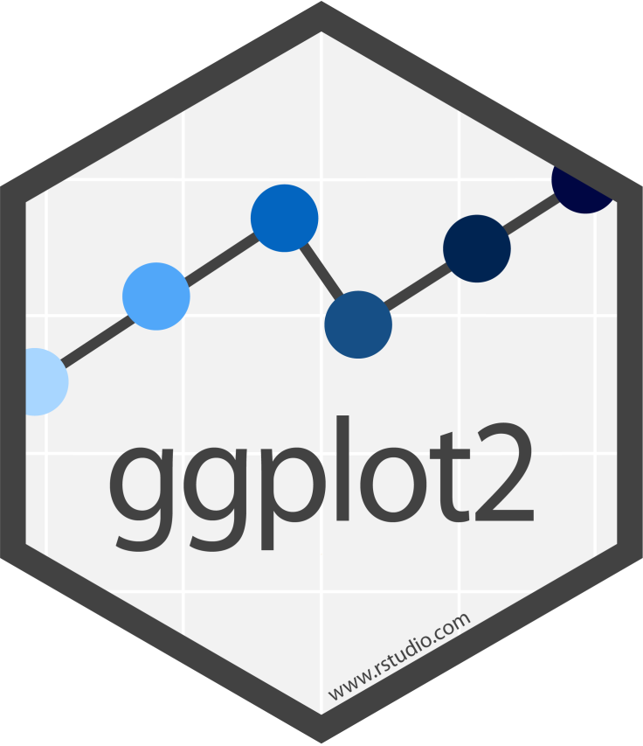

{tidyverse}
Notes:
tidyverse is a general name for many packages...
Additional packages: lubridate, tibble, readr, more
There are a lot of packages here so I'm going to review some of the major packages and when you should look to them. Simply too much to cover on each of them
Let's look at some of these packages based on their broad functionality
Any workflow is going to begin with reading in data

Slide 7


Reading and Writing Data
Read and write *.xlsx and *.xls files
Read and write most delimited data formats (*.csv, *.tsv, etc.)
Create tibbles interactively
Notes:
Readxl most applicable to most of you because LAVA output
Readr has generalized approaches for reading in tabular data such as CSVs, TSFs, etc. and other files like .zip or compressed tarballs
Tibbles are a concept that I’ll cover at next week’s presentation, but for all intents and purposes they are another form of data frame or data table and all of the read functions from readxl and readr will turn your data into a tibble (which is a good thing)
If you have odd file formats like those from SAS and STATA, look at the {haven} package

Slide 8
Cleaning Data: Fundamentals
Fast, consistent tools for working with data frames
Create tidy datum/data
Notes:
Arbitrarily separated packages that both serve some of the essential goals in any data cleaning process although I certainly use functions from {dplyr} far more commonly than {tidyr}
I think the logos capture some of the idea in how these packages are different
pliers to mold and reshape frames
Broom, dustpan to clean up observations
When I want to clean and manipulate my data, I start with large changes to the data frame like adding and deleting columns or changing column-wide values. Then I move to tidyr for deeper cleaning procedures
Not saying this is a precise workflow in any way at all—just a note based on my experiences with cleaning data
Ultimately, these packages really go hand-in-hand and the distinction between the 2 is arbitrary. If you need to clean, look to these packages.

Slide 9

Cleaning Data: Advanced
Process character strings/text
Reorder and modify factor levels
Work with date-times and time-spans
Notes:
Stringr built to easily interface with character vectors; extract, substitute, remove, and otherwise alter strings explicitly or with regular expressions
Functions recognizing Unicode values
Forcats built to interact with factor vectors: largely useful for lumping numerical data into categorical data with readable code
Lubridate built around the idea that dealing with dates and times should be easy, and does all of the work for you in converting dates to various different formats and calculating over time. Invaluable for any sort of time-series work
Find it easier to work with this than remembering POSIXct or POSIXlt
Automatically deals with differences in month lengths, leap-years, and so on

Slide 10
Other Powerful Packages
Workflows and the forward pipe operator, %>%
Easy, simple, and beautiful plot creation
Iterate functions over lists and data frames
Notes:
Magrittr: this is not a pipe, The Treachery of Images
Magrittr mostly known for the forward pipe which passes results from one step to the next step; to be demonstrated
Ggplot2: most common graphics plotting device in R, most adaptable, and the prettiest
Purrr: introduces various permutations of the map() function so you can iterate functions over elements of lists or data frames.

Slide 11
Essential Packages and Functions
{magrittr}
Make the whole process easy
{readxl}/{readr}
Read-in data
{dplyr}
5 major verbs for data cleaning
{ggplot2}
Quick and easy plots
Notes:
I've parsed this list down to an essential list that is great for just starting up on using R
Note on magrittr: everything to be mentioned will be woven together with the magrittr pipe function
Read-in data
Teach 5 major verbs
Finally, demonstrate ggplot2. Won’t really be covering how to use it, but I want to show you how it fits with everything else because of how essential data visualization is to everyone listening
Ok, let’s switch over to some of the practical information now

Slide 12
{magrittr}
Package supplies the pipe, %>%, operator
Allows function writing in a continuous flow; reduce wrapping
No more: foo(foo(foo(foo(x)))))
Read the pipe as an “and then” statement
read_csv(“data.csv”) %>% mean(col1)
Read in my .csv AND THEN find the mean of col1
Notes:
Have made several mentions to the pipe, %>%, operator supplied by magrittr
Avoid wrapping functions endlessly
Wrapping becomes needlessly large
Did anyone notice the error with my function writing? Do I have the correct number of closing parentheses? No, but you can barely even notice
Can chain together basically an infinite number of functions so that your file is readable in a line by line format
Also, my syntax for mean() is technically not a real function call, but we’ll get to that. Just want to demonstrate the idea concisely here.

Slide 13
{readr}
Multiple functions for reading and writing delimited files
Tab, colon, period, etc.
Functions you’ll care about
readr::read_csv(“./Files/data.csv”)
readxl::read_excel(“./Files/data.xlsx”, sheet = 1)
Working directory!
getwd() and setwd()
here::here()
Notes:
New item! Note the {package} and :: combination. This notation allows you to explicitly call function X from package Y
You all will mostly care about these two functions
When reading in data using these functions, they start looking for the file you name from the current working directory. You can find out your current working directory by typing getwd() which is just useful information to know. Take a look at the notation “./File/data.csv”
Let’s say my wd is my Desktop so on my MacBook that’s "/Users/pcallahan/Desktop”

Slide 14
{dplyr}
Improved syntax over base R data cleaning operations
Familiar syntax for SQL users
#1 package to learn, bar none
5 major functions
Notes:
Familiar to SQL users—in fact, the functions we’re about to see are exact counterparts, and they generate SQL code under the hood so you can interact directly with a SQL database if that’s a need. Great if, for example, working with high dimensional data from an EMR or other database
Note that the predecessor the dplyr, plyr, is now an abandoned package. If you have code dependent on plyr, that’s fine—it will keep working. However, you should switch to dplyr
I note this because a lot of older StackOverflow results will talk about plyr, and you should know these are distinct packages
Because of its importance, let’s quickly learn the 5 core functions of this package

Slide 15
{dplyr}: select()
Allows you to choose columns from a data frame, no quotes needed
Tidyselect Helpers
var1:var10 for a range of variables
-c(var1) to drop variables
Regex matching functions
Notes:
Tidyselect helpers offer a variety of methods for choosing which variables from a frame to keep or delete, and really comes in handy when you’ve been given a really wide dataset

Slide 16
{dplyr}: filter()
Arbitrarily create data filtering conditions
Superior syntax and extensibility compared to base R
dataframe[dataframe$var1 > 1, ]
dataframe %>% filter(var1 > 1)
Can accept any number of filtering arguments by separating with “,”
Also can use OR, |, operations
Notes:
Filter on conditions
A bit of an improvement over Base R for one condition, but the Base R syntax doesn’t hold up well when you want to make your filtering extensible with multiple conditions
This is where dplyr::filter() really shines, when you have more than 1 condition.
Moreover, the Base R method can technically be made to work with the pipe operator but it’s ugly and difficult to remember
Stats::filter and dplyr::filter WARNING. I always explicitly declare dplyr::filter because the stats package causes headaches

Slide 17
{dplyr}: mutate()
Create new columns in a dataframe
Do not need to pre-initialize the column like you would in base R
New column will automatically have N rows to match the dataframe
Essentially any operation or set of values is allowed
Ex: create a new column that is 2x an existing column
Notes:
The mutate function mutates the dataframe in some way, and typically is used to create new columns
It can also be used to overwrite existing columns if you use the same name. This can be a blessing and a curse
Column automatically matches length of the dataset
Can really do anything you want: all empty values, values that are 2x an existing column, or use some information that’s external to the dataframe

Slide 18
*{dplyr}: mutate_at()
Special version of mutate(), referred to as a scoped variant
Scoped variants exist for all dplyr verbs discussed today, but this is a mainstay
Applies a function to existing column(s)
Ex: set out-of-bounds values (88, 99, etc.) to NA
Notes:
Apply a function to a column without overwriting the values, which is what mutate can often be used for
at, each, all variants
Technically deprecated syntax, but will be good to use for many more years

Slide 19
{dplyr}: arrange()
Sort data on given column(s)
Default ordering is ascending, but can specify descending with desc()
Affects how the dataframe looks when viewed
WARNING: will alter calculations depending on row position/number…(so don’t do this.)
Notes:
So you can sort on multiple columns at once. The order in which you write the column names provides precedence information
View can be ascend and descend—main point is to get a view of your dataset
Cosmetic changes for the most part

Slide 20
{dplyr}: summarise()
Create summary values over the whole dataset
Often paired with the group_by() function to calculate summary values over certain vars
Returns a tibble with just the summary results
Notes:
Finally, we get to our 5th main verb from the package
Summary variables such as mean, median, or sd are fairly simple and standard datapoints you could collect, but summarize() is extensible to any sort of complex calculation you'd want to calculate.
Basically, if you can write a function that returns numeric values, you can use the summarize function on the starting data.

Slide 21
{tidyverse}: Worked Example
Order of operations matters
Imagine doing the following sequence without the chain operator
Feel free to ask about other operations you might want to do!
Notes:
Recognize that a lot of this may have been a bit nebulous, and not everyone learns in the same way so it’s all best tied together with an example of how to use the functions and packages together
Didn't want to get bogged down in code and syntax very much while talking about the functions and packages generally, but now we'll move to examples of all the major points I just covered
As we go through, keep these thoughts in mind:
See slides

Slide 22
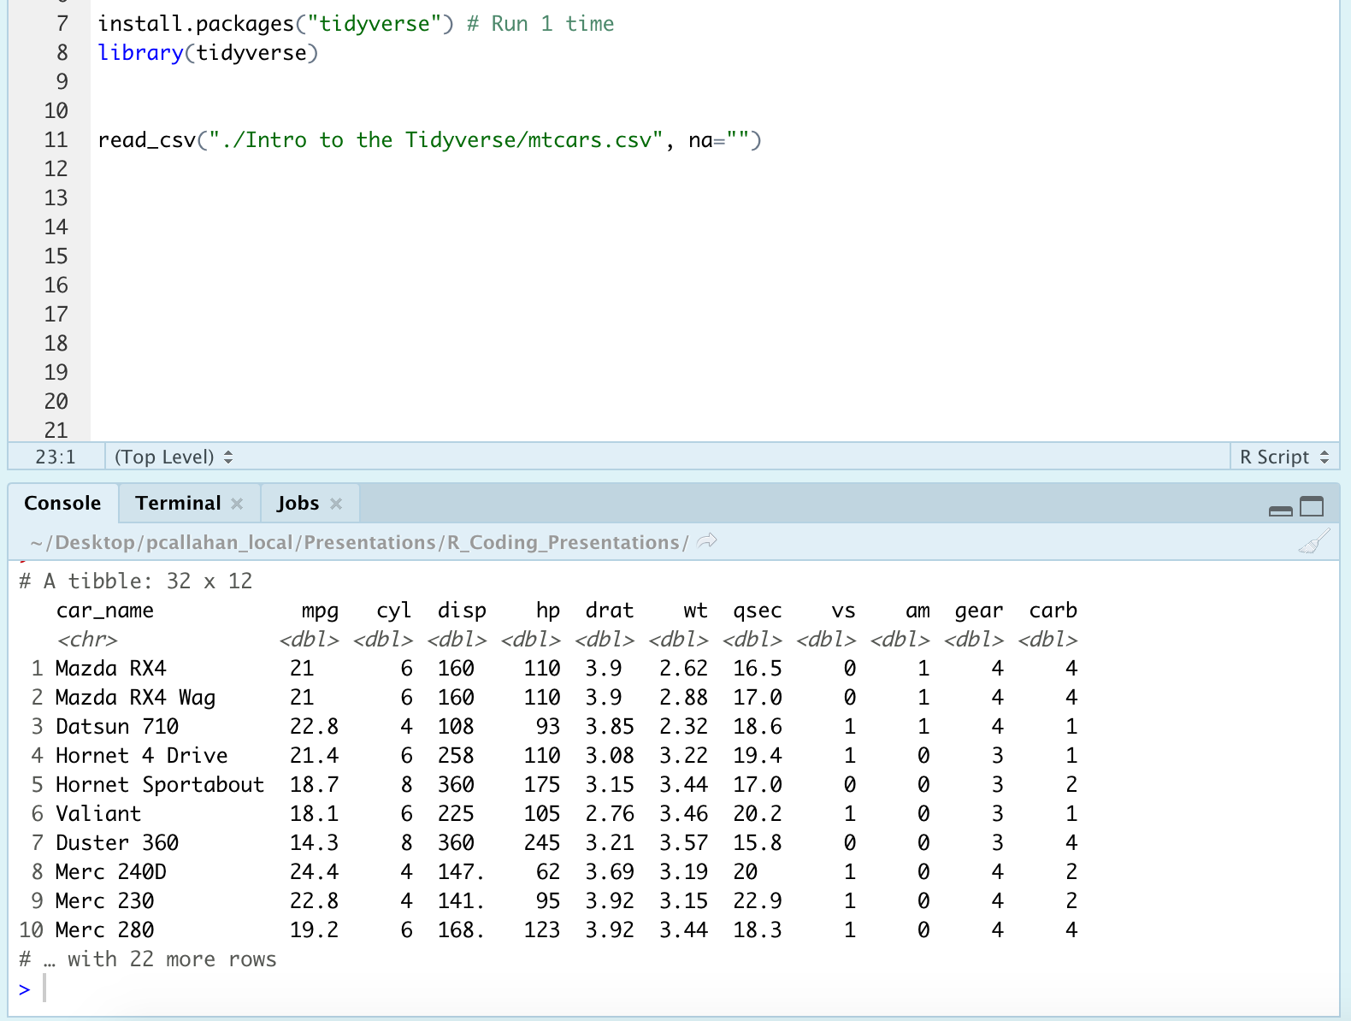
Notes:
Install the packages, and then load them for this R session
Run the read_csv() function to bring in the data
Note the print-out of the table that shows the first 10 rows
Note the meta-data that is also printed, including the number of rows and columns in the data-frame
Check out the column names, and the classes of the variables. The read_csv() function does its best to guess classes when reading in the data

Slide 23
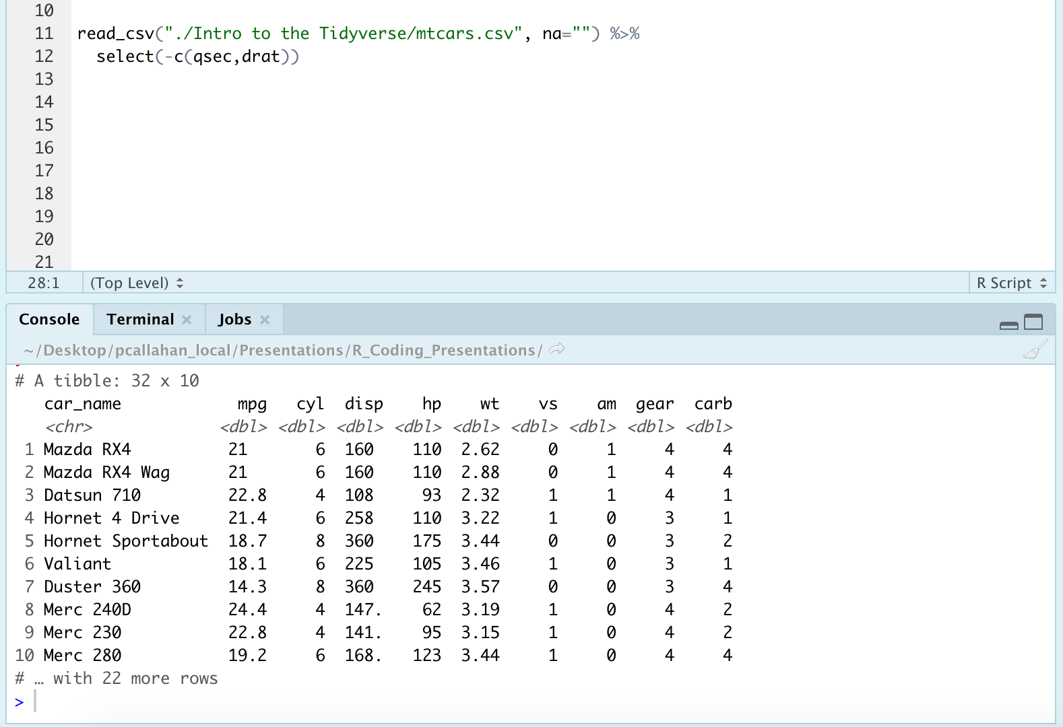
Notes:
Select() function to drop 2 variables, qsec and drat. Note the use of the minus sign followed by c() to let select() know I was entering a vector of variables to be dropped
Here is our first use of magrittr! We chained two operations together, reading in the data, and then dropping 2 variables from that data. Super simple in practice.
Print out no longer has those two columns
Metadata in the print out shows that we’ve dropped from 12 to 10 columns

Slide 24
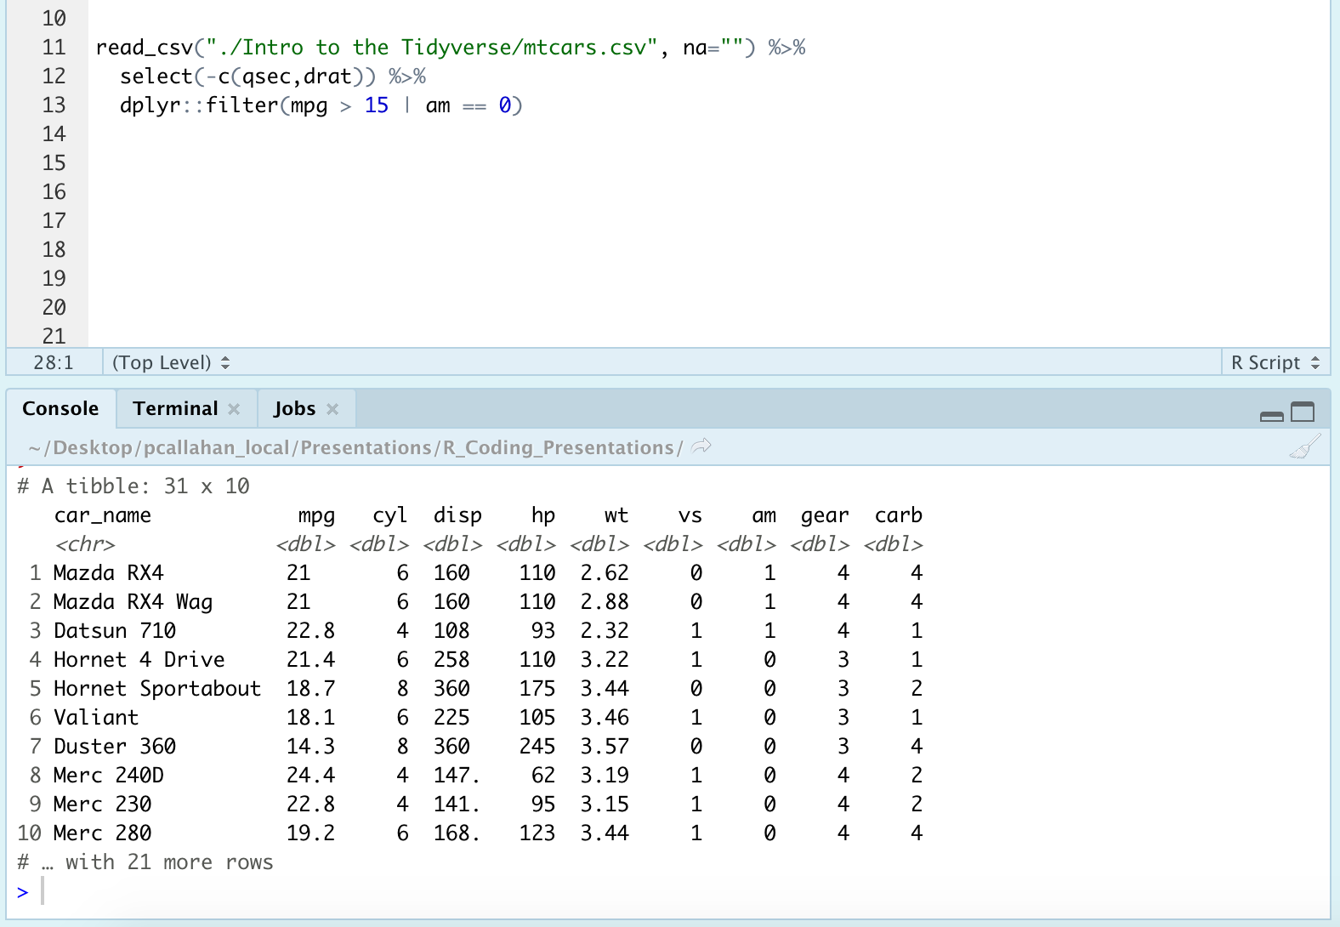
Notes:
Use of the filter() function to filter for rows where mpg > 15 OR am = 0. mpg is miles per gallon, and am indicates whether the car is automatic or manual. Note that I’ve explicitly declared the fxn with the dplyr:: notation.
If we look at the tibble print-out, we can see that our data frame went from 32 to 31 observations meaning that mpg < 15 for one of the manual cars

Slide 25
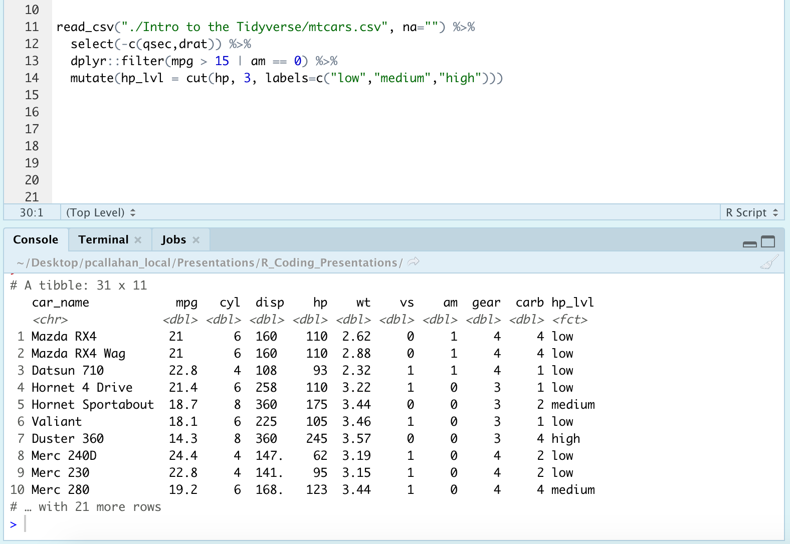
Notes:
Mutate to create a new column called hp_lvl. This hp_lvl variable is going to be a categorical cut of the hp, or horsepower, variable. So in this case, I’ve cut the hp values into tertiles, low medium high, based on where their hp value falls
The tibble now has 11 columns, a new one named hp_lvl.
The hp_lvl variable reflects the calculated position in the tertile ranges
Don’t stress the cut() function. The big idea here is that I used the mutate function to create a new variable of interest

Slide 26
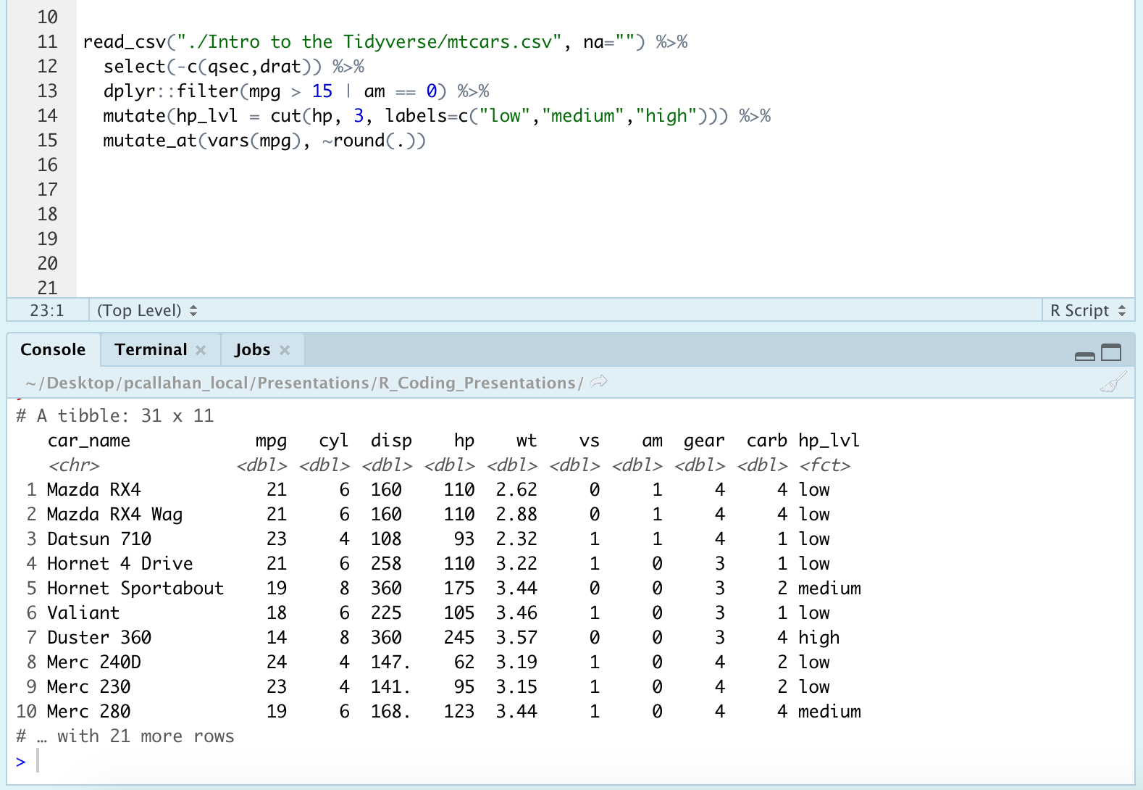
Notes:
Moving on from mutate, we jump to the scoped variant I had mentioned called mutate_at()
The mutate_at() call: we’re going to take mpg, which is wrapped in the vars() function, and ask that the values of mpg be rounded using the round() function which comes with base R
Note that tilde and the dot (.) argument in round(). The tilde is R’s formula interface, and the dot just means we’re passing the value from the vars() function, which is mpg, to the round() function.
Take a look at the mpg column to see that the values have now been rounded! Nothing has been overwritten, and no other columns have been affected

Slide 27
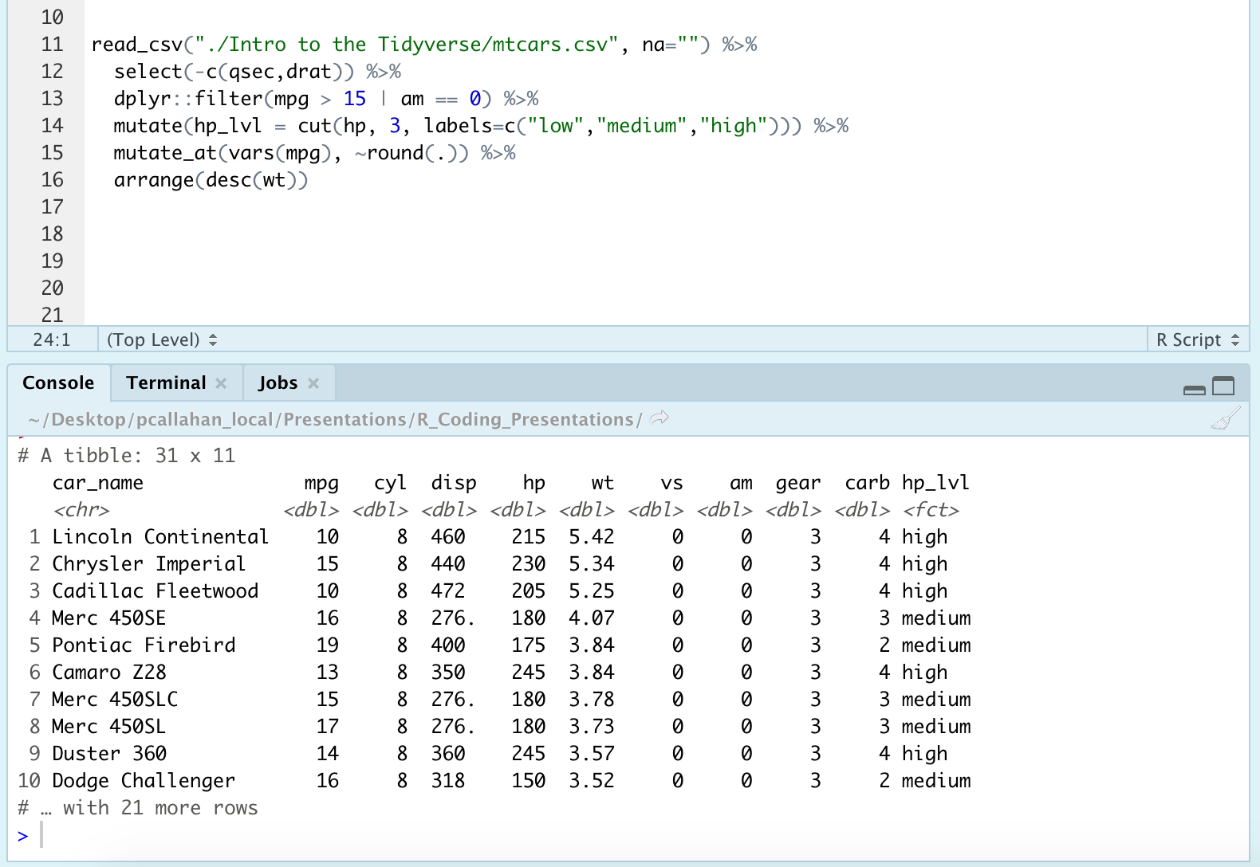
Notes:
The arrange function to arrange the order of the dataset, is mostly cosmetic. In this case, I opted to do descending order which is why wt, or weight, is wrapped in the desc() call
You can see the cosmetic changes as the data frame is ordered descending value of weight

Slide 28
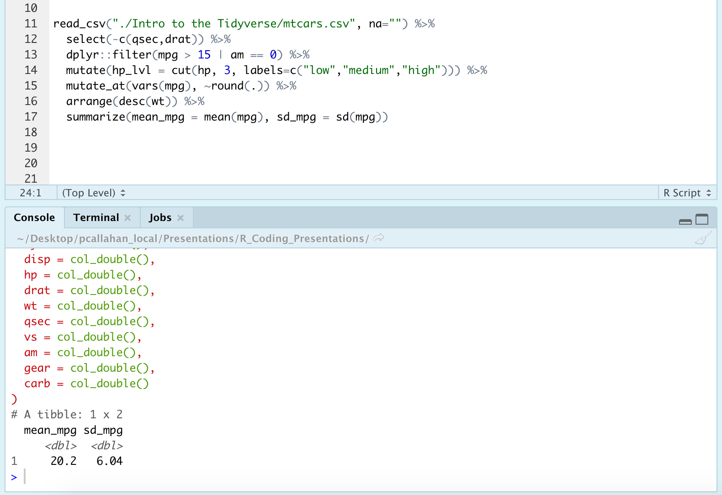
Notes:
Finally, we have all of this data, and we want to be able to report some measures of central tendency for a variable. Summarize function great for this and here it's used to create two columns, named mean_mpg and sd_mpg. Unsurprisingly, these columns are going to be the mean and sd of mpg for all of the cars in our dataset
Results displayed

Slide 29
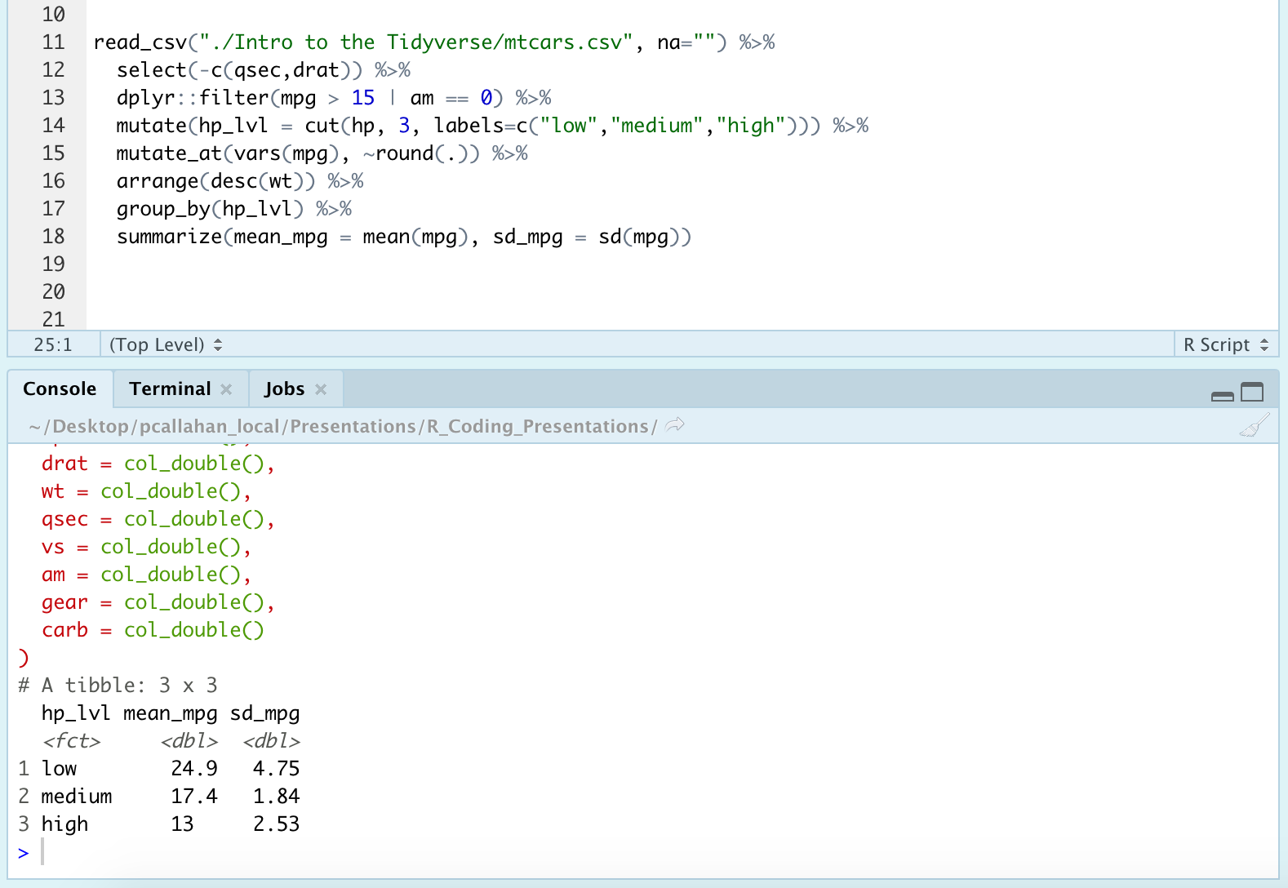
Notes:
We had discussed the group_by() function, and now I’m going to show you how it can quickly expand your analysis approaches
Use of group_by() to group analyses by the categorical variable we made earlier, hp_lvl
Now the summarize results break apart the earlier analyses by the 3 groups we found in hp_lvl. Super informative exploration of your data, providing 3 new sets of measures of central tendency with a single line of code. Didn't need to write a function to run these analyses 3 separate times on teh different levels, and then combine the data--it all just works together, and creates a unified output

Slide 30
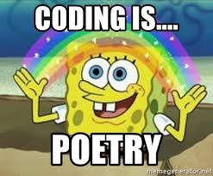
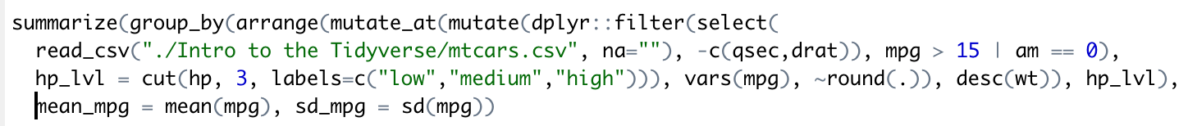
Without piping…
Notes:
I asked you at the beginning to imagine this process without using pipes...
Here’s what the whole process would look like without using the pipe operator, and without defining a half-dozen intermediate variables
This is machine executable code, but it is not human readable code.
If you presented this to me, I would not try to disentangle or troubleshoot it
Think of your code as poetry when you write it; make it poignant and easy to understand…or don’t.
So I had previously mentioned I’d give you a quick taste of ggplot2

Slide 31
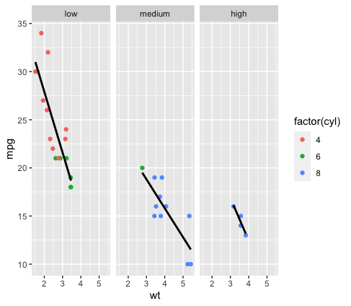
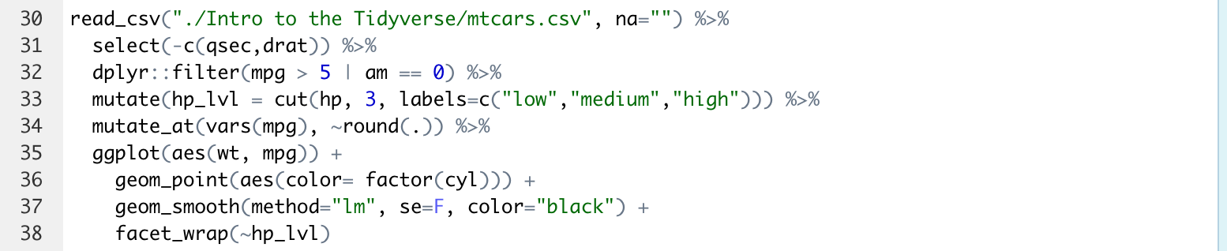
Sample of {ggplot2}
Notes:
Peeled back our code up to the point that I rounded the mpg variable so it’s still a dataset of 31 observations
Code: initialize a plot, add the points for wt vs mpg, add a regression line without standard error, and facet the plot by the hp_lvl variable
Produces this plot

Slide 32
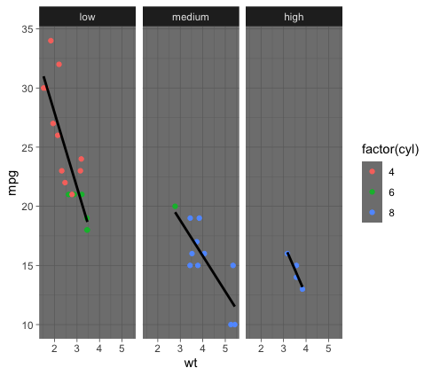
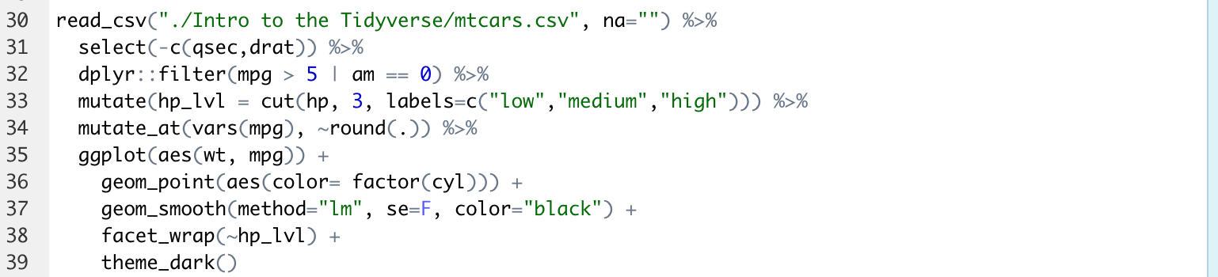
Sample of {ggplot2}
Notes:
Quick extension on the plotting capabilities is the thematic formatting that ggplot2 comes with, and the ability to create your own themes that are applicable across other projects.
Good examples are the BBC and 538 have themes that are publicly available as packages
Really the tip of the iceberg of what can be accomplished with the Tidyverse package

Slide 33
My Recommended Resources
Online:
Roger Peng and John Leek on Coursera
DataCamp (free and paid options)
https://homerhanumat.github.io/r-notes/index.html
Books:
Beyond Spreadsheets with R
R in Action
In R:
swirl()
RStudio cheatsheets
Notes:
Other books you might encounter:
R 4 Data science: don’t recommend for beginners, but is solid
R in Action 3rd edition: this is a good 2nd book to read
Most books from Manning Publications website are solid
Haven’t fully verify the book by Homer Hanumat, but it was updated just a month ago and seems to cover all the important topics

Slide 34
Questions?
Slides available on my GitHub, NeuroShepherd, in the R_Coding_Presentations folder
Video recording to be posted on MACipedia Data Science and Coding page

